Slide 1
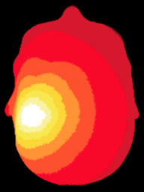
NeuroDOT
Tutorial:
Generating a Light Model
32x32 Full Head Pad

Slide 2
NeuroDOT Set-Up - Checklist
Before starting any tutorial, please make sure you’ve done the following
Download the appropriate versions of matlab, neuroDOT, and NIRFAST
Matlab: 2020b
NeuroDOT toolbox from NITRC
https://www.nitrc.org/projects/neurodot/
NIRFASTer-master
https://github.com/nirfaster/NIRFASTer
Set your path so that all required folders and subfolders are included
Folders w/subfolders to include
NeuroDOT toolbox
NIRFASTer-master
Your personal directory
Folders to include
Output directory

Slide 3
NeuroDOT Set-Up – Output Directory
Example output directory
Once you’ve set your path, the next thing you should do is set your output directory.
The output directory must be located within your path
If it isn’t already in your path, you must add it to your path
You can set your own path to an output directory in the line shown above
An output directory specifies the location where files will be saved
MATLAB, by default, will save files to the current directory
The following line of code will change your current directory to the output directory that you just specified →
Now you can save outputs directly to your output directory

Slide 4

Diffuse Optical Tomography
In diffuse optical tomography (DOT), arrays of optical sources and detectors are used to perform functional neuroimaging experiments on task-based or resting state modes of human brain function.
Analyses are broken into several pipelines:
B: modeling of the tissue shape, optical property distribution, and source/detector locations
C: modeling of the light emission, diffusion, and detection through the head
D: preprocessing of the raw source-detector measurements
E: reconstruction and spectroscopy of the preprocessed data and light model into a functional neuroimaging volume
F: post-processing analysis of these results.

Slide 5
Light Modeling Tutorials in NeuroDOT
NeuroDOT has several different tutorials that detail how to Generate a Light Model, each with its own purpose. They’re listed below to help you figure out which version is the best for your purposes.
Basic Light Modeling Tutorial with AlignMe
PPT: NeuroDOT_Tutorial_Generating_a_Light_Model_Pad_24x28_With_AlignMe
Script: Basic_Light_Modeling_with_AlignMe_Tutorial
Pad file: Pad_AdultV24x28.mat
Sparse Pad Tutorial with AlignMe
PPT: NeuroDOT_Tutorial_Generating_a_Light_Model_SparsePad_32x32_With_AlignMe
Script: Basic_Light_Modeling_with_sparse_Pad_and_AlignMe_Tutorial
Pad file: Pad_FullHead_32x32.mat
Light Modeling with a Subset of Measurements
PPT: NeuroDOT_Tutorial_Generating_a_Light_Model_With_Subset_of_Measurements_Pad_24x28_and_AlignMe
Script: Light_Modeling_with_Subset_of_Measurements_and_AlignMe_Tutorial
Pad file: Pad_AdultV24x28.mat
Split Pad Tutorial
PPT: NeuroDOT_Tutorial_Split_Pad_Light_Modeling_With_LUMO_Adult_Temporal_Pad_and_AlignMe
Script: Split_Pad_Light_Modeling_with_LUMO_Adult_Temporal_Pad_and_AlignMe_Tutorial
Pad file: LUMO_adult_temporal_pad.mat
Basic Light Modeling with Hummingbird
PPT: NeuroDOT_Tutorial_Generating_a_Light_Model_Pad_24x28_With_Hummingbird
Script: Basic_Light_Modeling_with_Hummingbird_Tutorial
Pad file: Pad_AdultV24x28.mat
Sparse Pad Tutorial with Hummingbird
PPT: NeuroDOT_Tutorial_Generating_a_Light_Model_SparsePad_32x32_With_Hummingbird
Script: Basic_Light_Modeling_with_sparse_Pad_and_Hummingbird_Tutorial
Pad file: Pad_FullHead_32x32.mat
Light Modeling with Adult 96x92 Pad
PPT: NeuroDOT_Tutorial_Generating_a_Light_Model_Pad_Adult_96x92_Example
Script: Basic_Light_Modeling_with_AlignMe_Tutorial_Pad_Adult_96x92
Pad file: Pad_Adult_96x92.mat
Note: this tutorial’s PowerPoint is in an older style

Slide 6
Generating a Light Model
This tutorial will follow the Basic_Light_Modeling_with_sparse_Pad_and_AlignMe_Tutorial.m Matlab file which can be found in the Documentation/Scripts folder.
The tutorial will:
Generate a mesh from a segmented volume
Place an array of sources and detectors on the mesh
Set multiple parameters for the model
Calculate the sensitivity A for this model
We will use a segmented volume, Segmented_MNI152nl_on_MNI111_nifti, found in Support_Files/Atlases, to generate the head model.
We will use the visual pad, Pad_FullHead_32x32.mat, found in Support_Files/Pad.

Slide 7
NeuroDOT Flowchart for Light Model Generation
MRI Acquisition
Image Segmentation
Mesh Generation
These steps are repeated for a low-density and high-density mesh
Optode Placement
Calculate Sensitivity
Validate Sensitivity

Slide 8
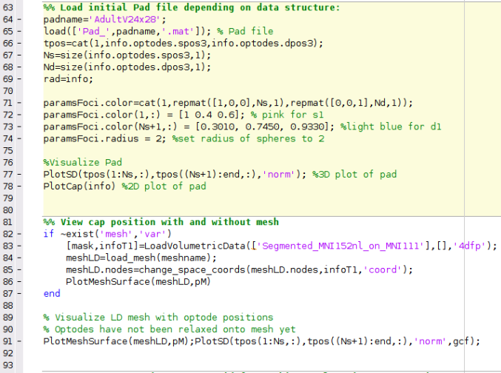
Running the script – Author’s Note
How the author runs the script
Highlight and execute each chunk of code
Ex: highlight lines 64-69 → right click → hit “Evaluate Selection”
Alternate way of running the script
For each section (beige) hit ctrl+enter
This isn’t how the author does it, but it will still work
Note: DO NOT HIT THE GREEN “RUN” BUTTON to run this script
MATLAB versions to use
Optimal version: MATLAB 2020b
The version that AlignMe was developed in
NIRFAST version to use
NIRFASTer, the newest release of NIRFAST
Found here: https://github.com/nirfaster/NIRFASTer
Example
section

Slide 9
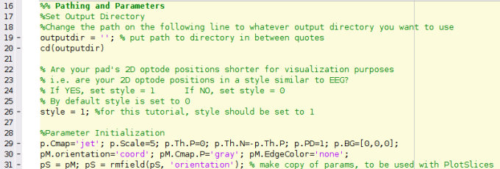
NeuroDOT Set-Up – In Script
The first section of code in this script will add the required toolboxes to your path and allow you to navigate to your desired output directory from within the script
Some parameters for visualizations made in the script are set up here as well

Slide 10
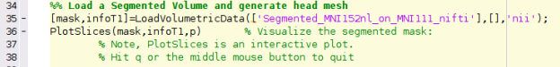
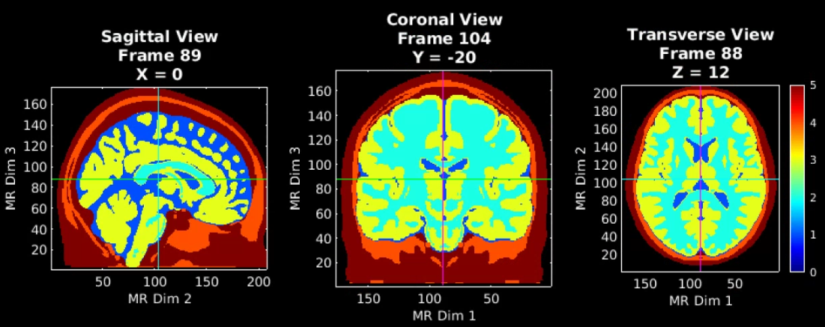
Load a Segmented volume and visualize
MRI Acquisition
Image Segmentation
Note that PlotSlices.m generates an interactive visualization of the volume. Simply press ‘q’ or the middle mouse button to release the figure.
5 – Scalp
4 – Skull
3 – Gray Matter
2 – White Matter
1 – CSF
0 - Background

Slide 11
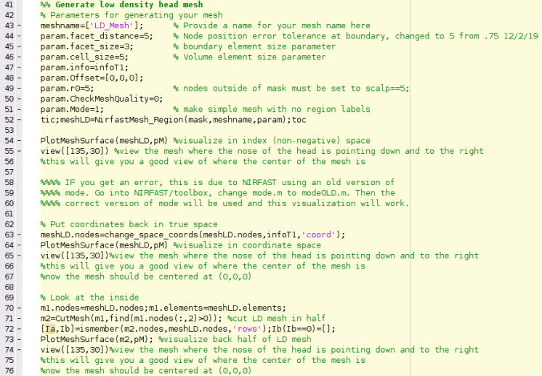
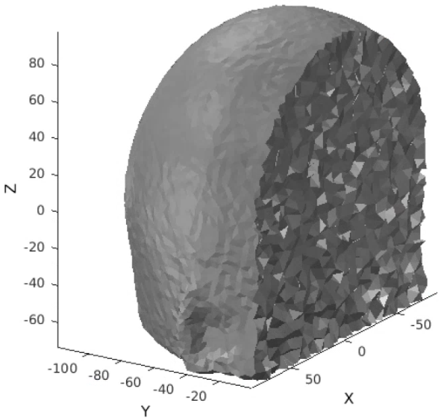
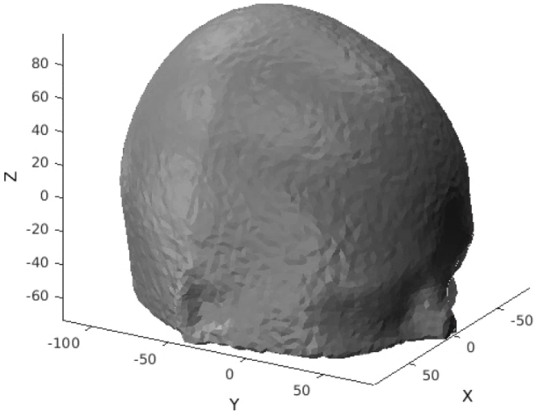
Generate a low-density mesh and visualize
MRI Acquisition
The low-density mesh will be used to efficiently align the optical array to its position on the head.
Image Segmentation
LD Mesh Generation
A view inside
“coordinate space”
The origin is in the center of volume

Slide 12
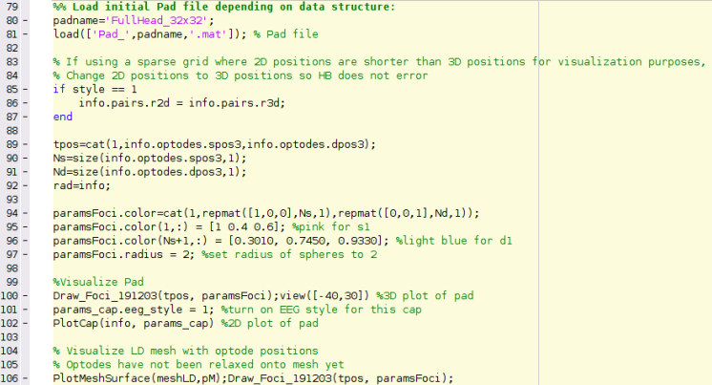
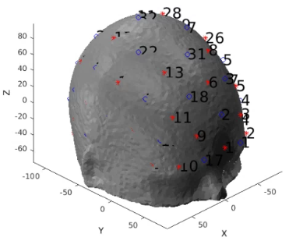
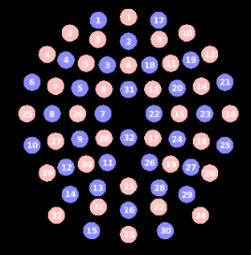
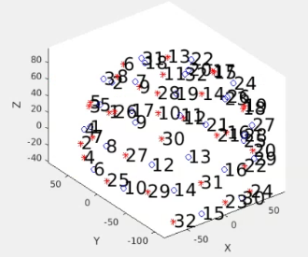
Place the optodes on the LD mesh
MRI Acquisition
Load in a Pad file for a grid design of interest, here we use the AdultV24x28 array.
Note: This Pad file is a starting point and may not align with the mesh right away.
Image Segmentation
LD Mesh Generation
Optode Placement
2D positions
3D positions

Slide 13
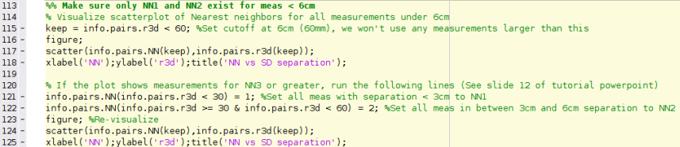
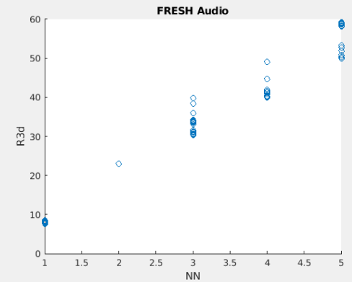
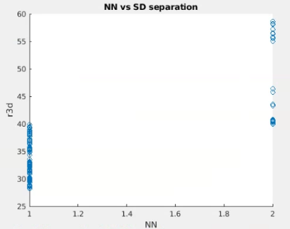
Check Optode Separation against Nearest Neighbors
MRI Acquisition
Image Segmentation
Nearest Neighbor vs Optode Separation scatterplot is a useful tool for catching potential issues for spring relaxation before they occur.
Visualize info.pairs.NN agains info.pairs.r3d. If the plot contains NN3, NN4, etc. Correct the info structure so that measurements < 6cm have only NN1 and NN2
LD Mesh Generation
Optode Placement
Before correction
After Correction
See, there are measurements for NN3, 4, and 5. This is what we want to correct
Now, only NN1 and NN2 remain
Note: The “before correction” plot is not generated in the MATLAB tutorial script

Slide 14
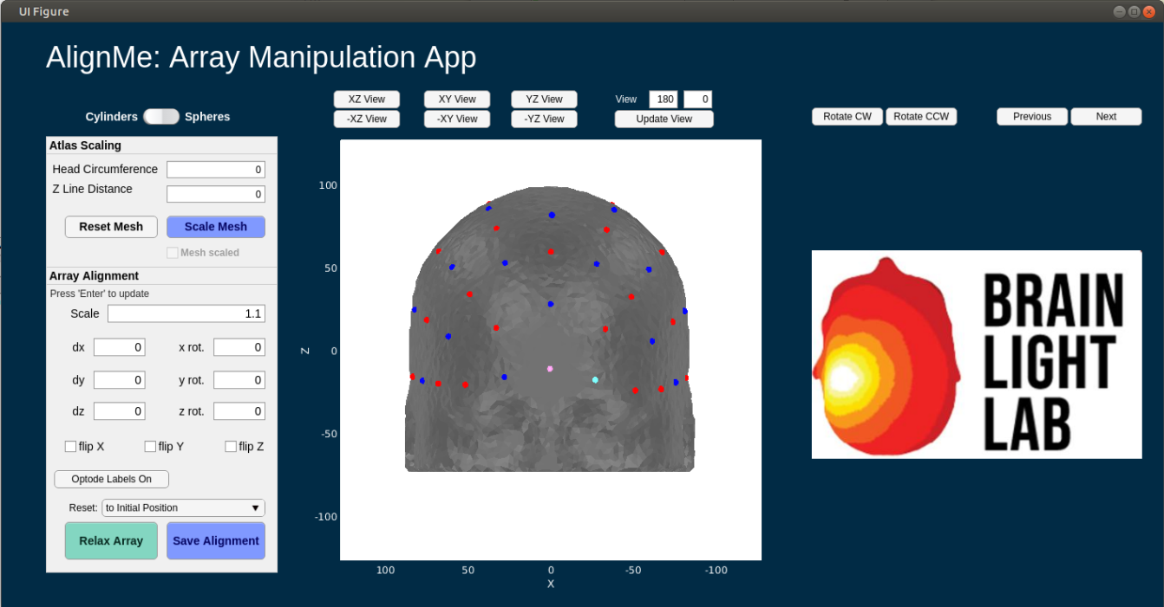
AlignMe Functionality
AlignMe allows for the user to scale the mesh to participant specific space by using
Participant Head Circumference
Participant Z line distance (nasion to inion)
These are contained within the Atlas Scaling box
Additionally, to facilitate easier alignment for participant specific situations, photos of the capfit can be utilized, and will show up where the Brain Light Lab logo is located on the GUI
Rotate CW, Rotate CCW: rotates photo
Previous, Next: scroll through available photos
Participant photos can be loaded in by setting the path to the directory containing photos. AlignMe will pull all files of the designated image type
Path to photos: ds.dI.photopath
Type of image: ds.dI.imageType
Note: The following 11 slides are an in-depth tutorial on how to use the AlignMe app
The mesh will not be scaled in this tutorial
There will not be any participant photos in this tutorial
You can find a standalone tutorial for using AlignMe in a matlab script titled: AlignMe_Standalone_Tutorial.m
Tutorial can be found in the Documentation/Scripts folder of the NeuroDOT toolbox
A powerpoint to go along with the script can be found in Documentation/Tutorials, it is titled: NeuroDOT_Tutorial_AlignMe.pptx

Slide 15
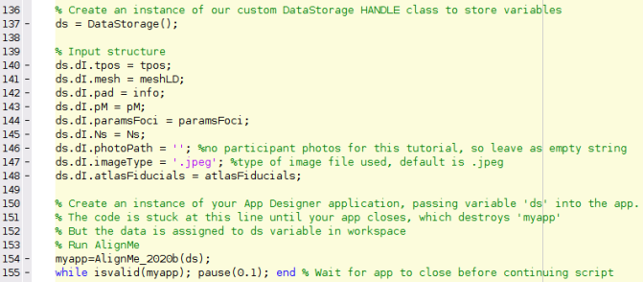
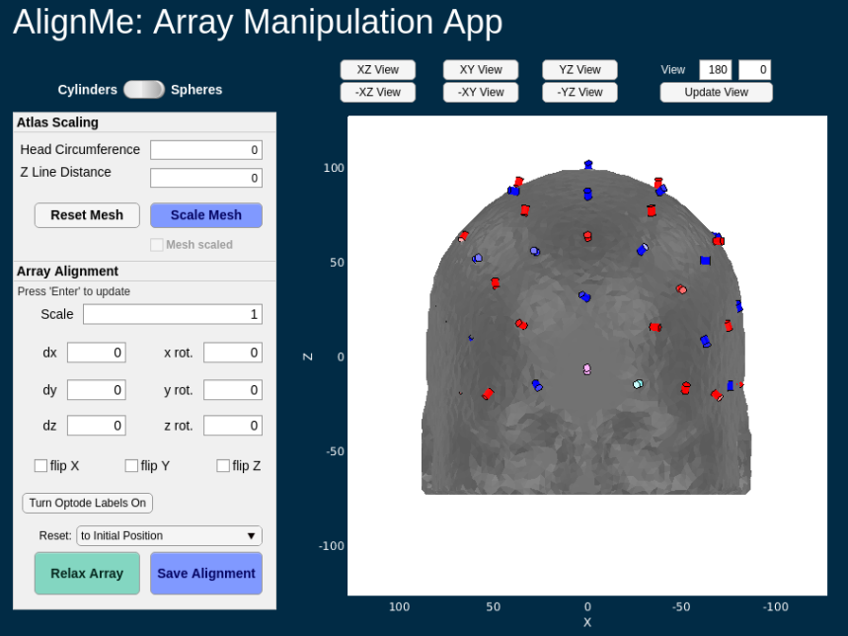
AlignMe Tutorial 1
Default view on AlignMe launch

Slide 16
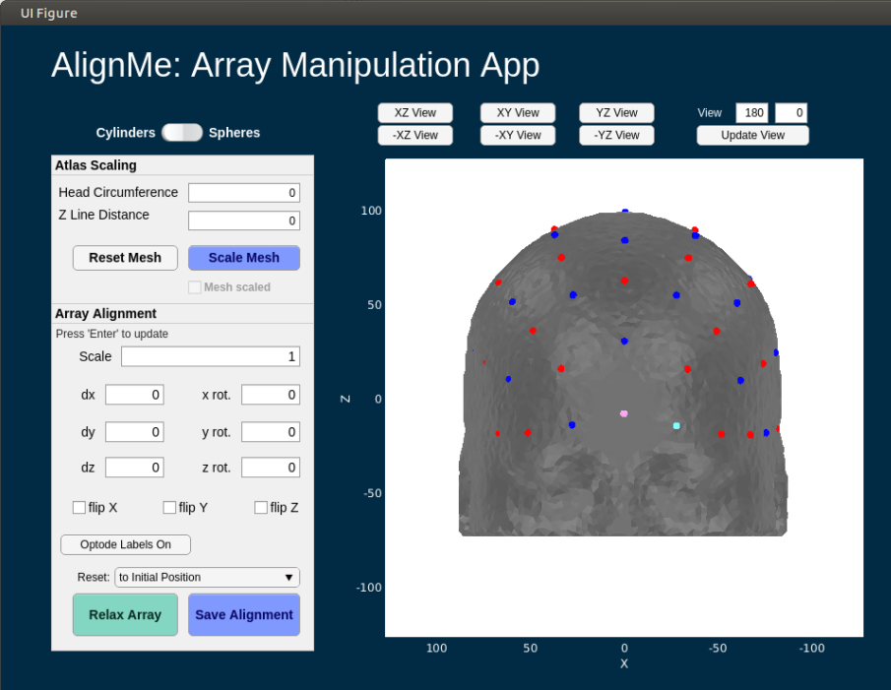
AlignMe Tutorial 2
First, lets switch to spherical optodes
Hit the switch above the “Atlas Scaling box”
There is a unique issue with running AlignMe on a LINUX device where you will be unable to change values in the edit fields on launch
This is due to a currently unresolved Matlab/Linux issue
To fix this, click on the “UI Figure” bar on the top of the app figure window
Default view on AlignMe launch

Slide 17
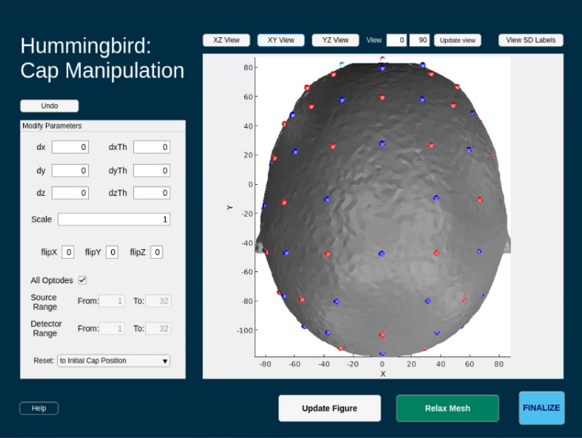
AlignMe Tutorial 3
Change the view to fully view the pad
The pad is the grid comprised of red and blue spheres; these denote optodes
Red = Source
Blue = Detector
Some optodes might start within the mesh
Switch to XY view to start

Slide 18
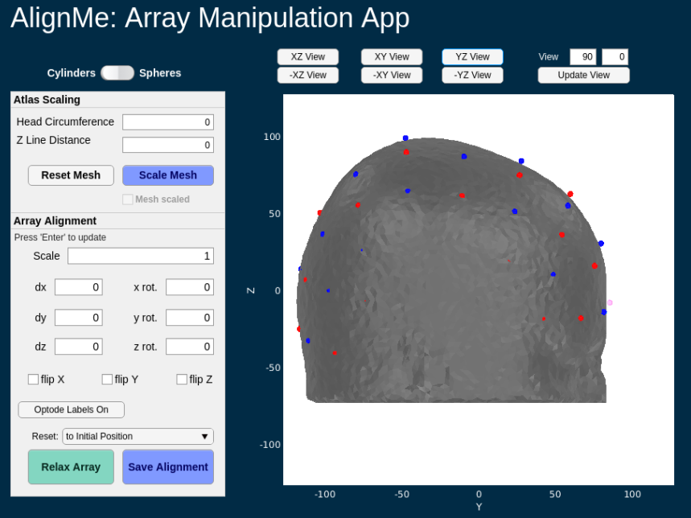
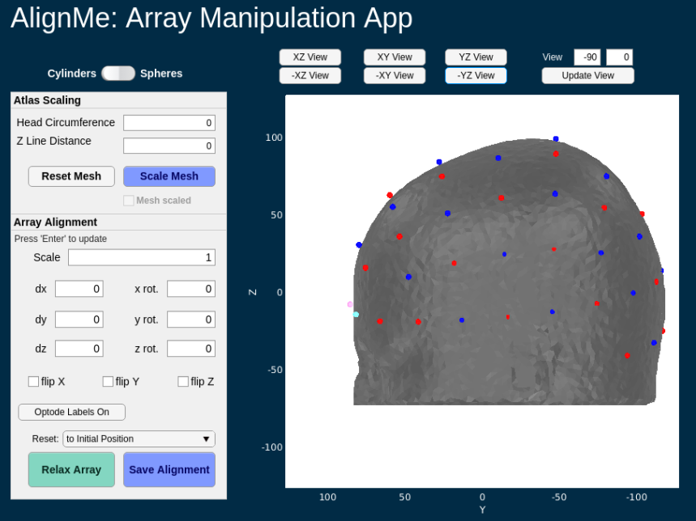
AlignMe Tutorial 4
Change the view to fully view the pad
The pad is the grid comprised of red and blue spheres; these denote optodes
Red = Source
Blue = Detector
Some optodes might start within the mesh
Now try YZ view
Note that some optodes aren’t visible right now because they’re inside the mesh
You can also manually set the view by editing the numbers
Set the first value to -90
Then hit “Update view”

Slide 19
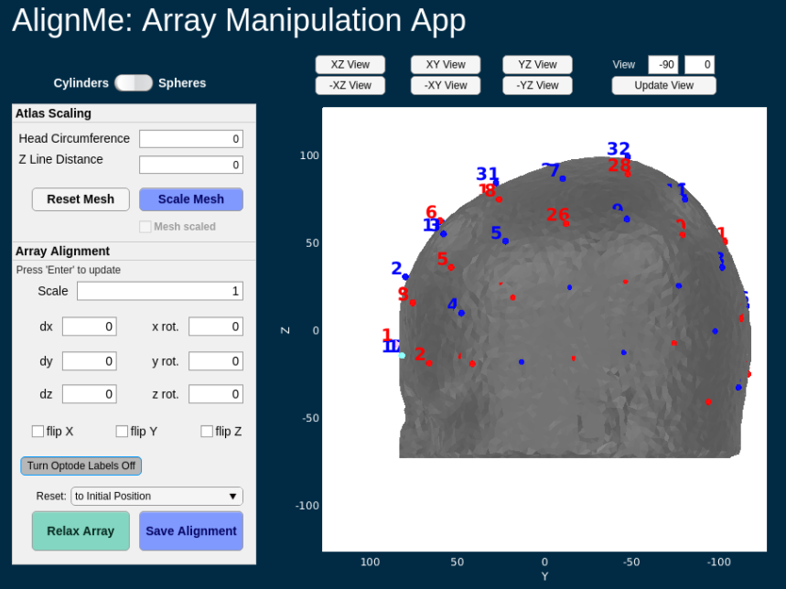
AlignMe Tutorial 5
You can also view source and detector (SD) numbers by hitting the “Turn Optode Labels On” button
If labels are off, button says
“Turn Optode Labels On”
If labels are on, button says
“Turn Optode Labels Off
Lets turn optode labels off for the rest of this tutorial

Slide 20
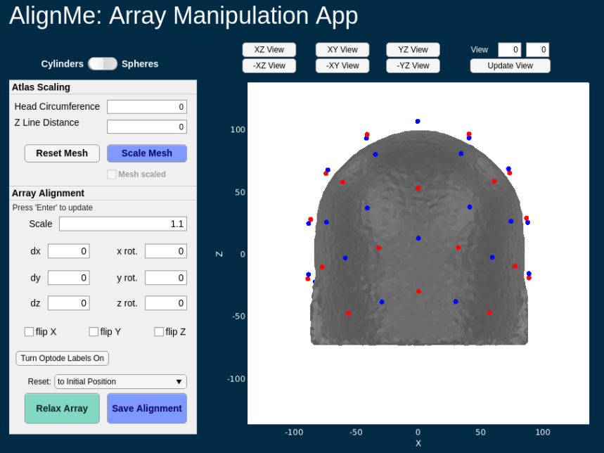
AlignMe Tutorial 6
Back to XZ view
Set scale to 1.1
Hit “enter”, “tab”, or simply click anywhere else on the app after changing an edit field and the app will automatically update
We want the optodes to be around 5-10mm AWAY from the head so that they can relax back on to it
Double check that all the optodes are away from the head by changing views

Slide 21
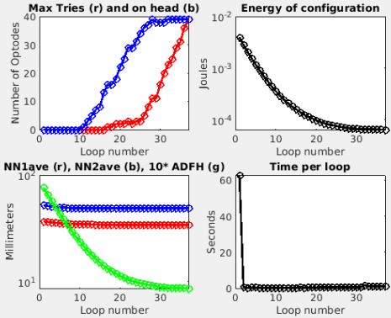
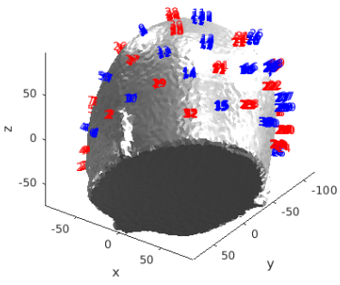
AlignMe Tutorial 7
Once you’ve verified that the pad position is correct and that optodes are away from the head, hit the “Relax Array” button
The below two figures will open and start to update
When relaxation is finished, the figures will look like below

Slide 22
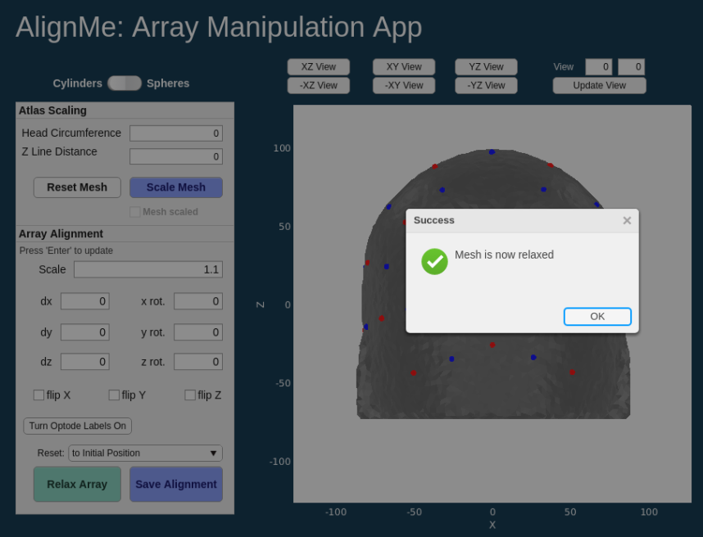
AlignMe Tutorial 8
Once optodes are relaxed onto the mesh, a dialogue box will show up on the AlignMe app
Hit “OK” to close it

Slide 23
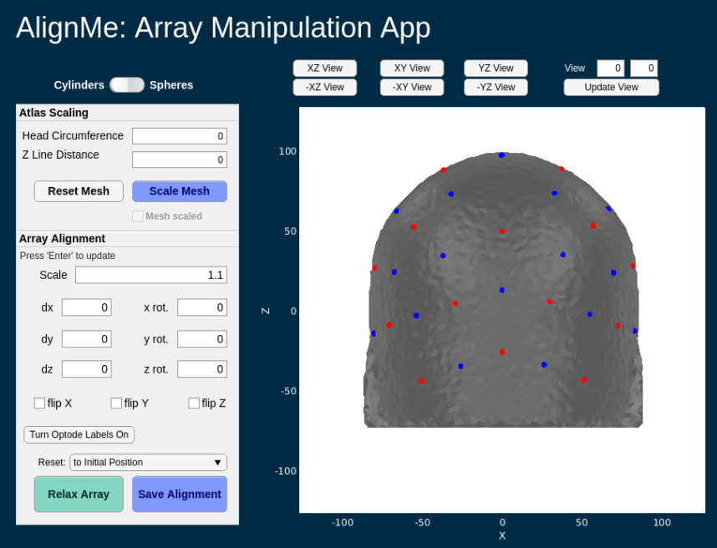
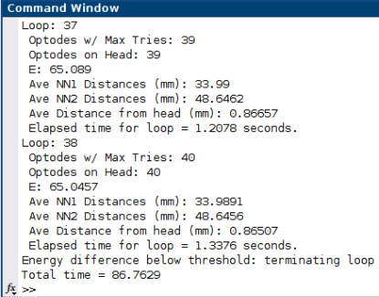
AlignMe Tutorial 9
To save the new optode locations to your MATLAB workspace, hit the “Save Alignment” button

Slide 24
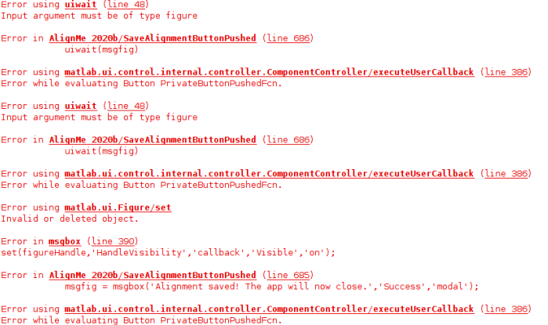
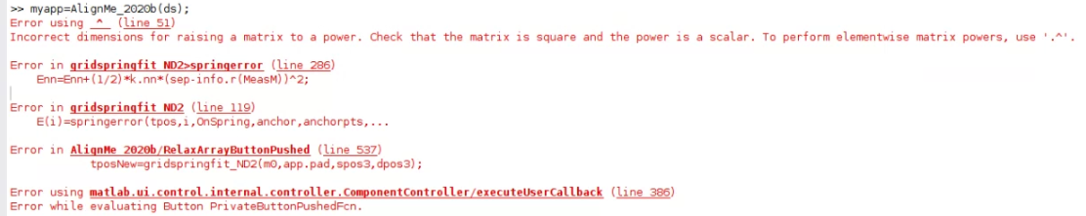
AlignMe Tutorial Potential Errors
Sometimes, when clicking the “Save Alignment” button, the error shown on the right occurs
Usually this is due to clicking the button multiple times before the app has finished running
To fix, just select 'Save Alignment' again
Make sure you only click once
Please be patient
See slide 12 for a fix to this error

Slide 25
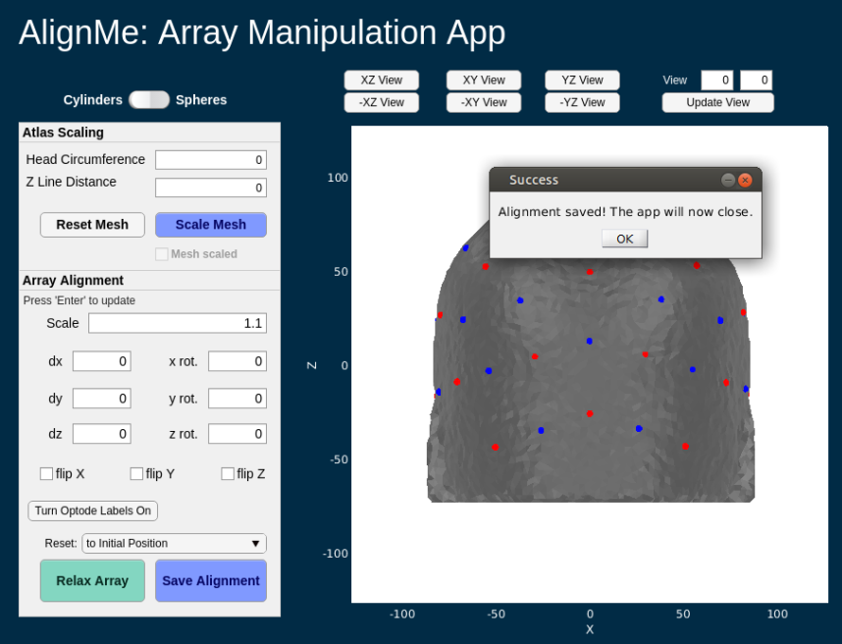
AlignMe Tutorial 10
A final dialogue box will open. Click OK to close AlignMe
You’ve finished the AlignMe tutorial!

Slide 26
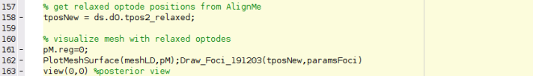
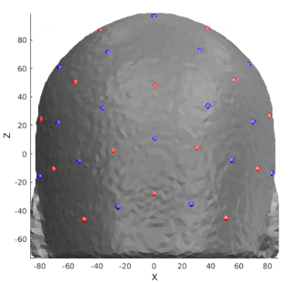
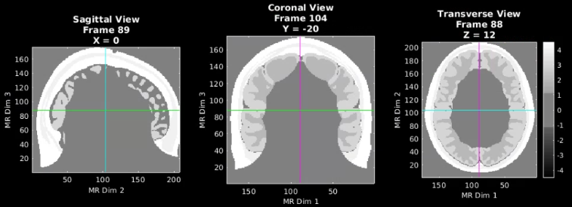
Generate smaller mask based on optode locations
MRI Acquisition
Here, we get our relaxed grid position and visualize it on the LD mesh. Then, we scoop out the part of the mesh that the grid is sitting on. This scooped section will is the basis for the high-density mesh that we are about to create
Image Segmentation
LD Mesh Generation
Optode Placement
HD Mesh Generation

Slide 27
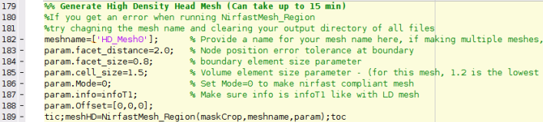
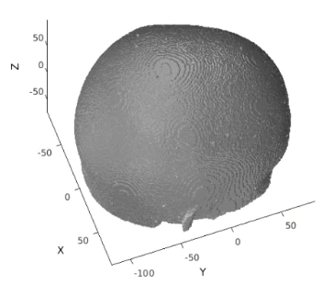
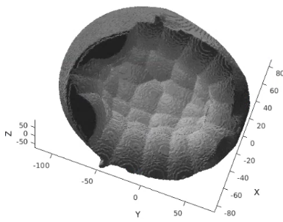
Generate a high-density mesh and visualize
MRI Acquisition
Take the scooped section of the LD mesh and turn it into a HD mesh
Image Segmentation
LD Mesh Generation
Optode Placement
HD Mesh Generation
Top View
Bottom View
Bottom view helps to make sure the mesh is totally hollow, with no connected strands on the inside

Slide 28
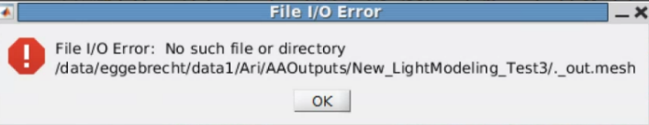
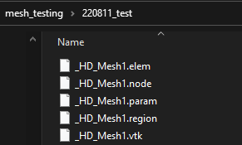
Generate a high-density mesh and visualize
Notes and possible errors
Possible Errors in HD mesh generation
File I/O Error:
Solution: delete all mesh files in your output directory, change the meshname variable to a new name and re-run
Ex: ‘_HD_Mesh1’ → ‘_HD_Mesh0’
Make sure you delete these files from the file manager, and NOT within matlab
If the above doesn’t work, create an entirely new output directory, make that directory your current folder, then re-run lines 149-168
Poor mesh quality
Occurs if number of nodes in mesh is greater than 1,000,000
This is why we make smaller HD meshes and tune params.cell size
Parameters
Cell_size = size of internal tetrahedra
This can be changed to ensure that the number of nodes in the mesh does not exceed 999,999
For HD meshes, this is typically set to 1.0 for visual pad, and 2.0 for larger volume meshes i.e. full head
Facet_distance = error tolerance at boundary for node positions
Typically set to 2.0 for HD meshes
Facet_size = size of surface triangles of mesh
Want to keep this as small as possible, as we want the surface to be highly faceted
Typically set to 0.8 for HD meshes
Pop-up box for File I/O Error
Files to delete if File I/O Error occurs

Slide 29
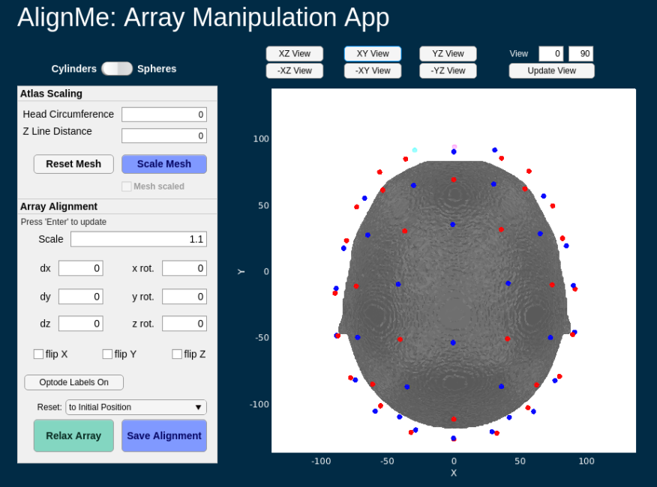
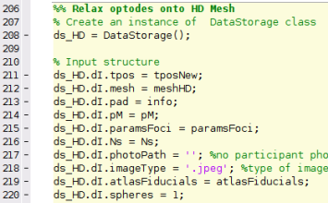
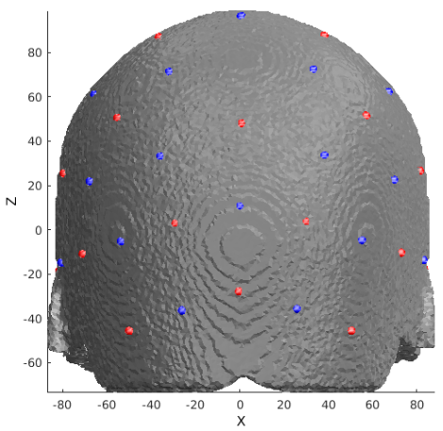
Place the optodes on the HD mesh
MRI Acquisition
This time, since the HD mesh is in the same space that the LD mesh was, the grid will already be lined up and sitting on the mesh when AlignMe starts. You’ll need to move it away from the mesh and re-relax the grid back onto the mesh
Scroll through all views of the mesh/pad and make sure no optodes are sitting inside the mesh
Switch from cylinders to spheres
Adjust the scale to 1.1 (this is the scale we used for the LD mesh too)
The AlignMe GUI should now look like the image below
Hit “Relax Mesh” and then “Save Alignment” after the grid has been re-relaxed onto the mesh
Image Segmentation
LD Mesh Generation
Optode Placement
HD Mesh Generation
Optode Placement

Slide 30
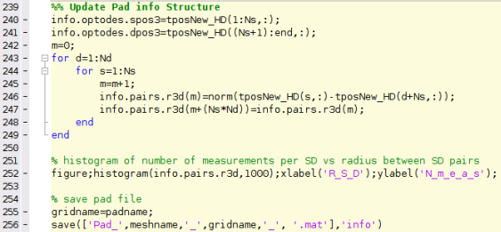
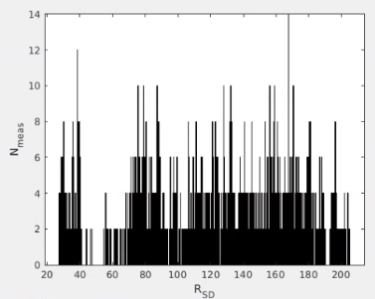
Update pad info structure after running Hummingbird
After the pad has been relaxed onto the HD mesh, we need to update the info structure with the new optode locations
MRI Acquisition
Image Segmentation
Mesh Generation
For both LD and HD meshes
Optode Placement

Slide 31
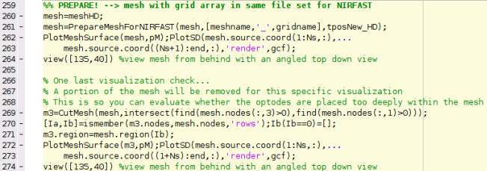
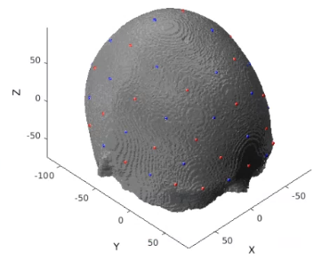
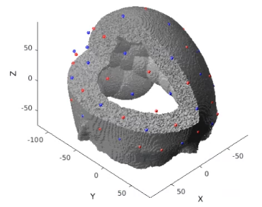
Calculate the sensitivity (1 of 3)
Prepare mesh and optode information for NIRFAST, then visualize
Visualize cap and mesh with portion cut out to make extra sure that optodes are not placed too far within the mesh
MRI Acquisition
Image Segmentation
Mesh Generation
For both LD and HD meshes
Optode Placement
Calculate Sensitivity
1.
2.

Slide 32
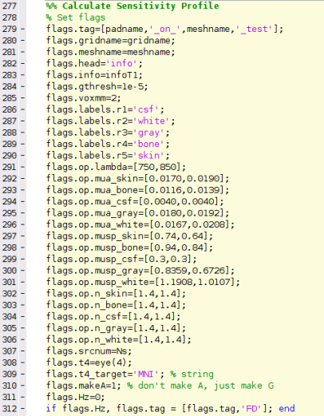
Calculate the sensitivity (2 of 3)
3. Set parameters for light modeling
MRI Acquisition
Voxelation resolution
Image Segmentation
Region labels
Mesh Generation
For both LD and HD meshes
Absorption Coefficients for regions
Optode Placement
Scattering Coefficients for regions
Calculate Sensitivity
Index of refraction for regions

Slide 33
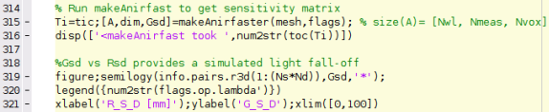


Calculate the sensitivity (3 of 3)
4. Calculate Green’s functions, voxelate, create sensitivity matrix, adjust bookkeeping
If makeAnirfast is successful, info like the below screenshot should show up in your command window
MRI Acquisition
Image Segmentation
Mesh Generation
For both LD and HD meshes
Optode Placement
Calculate Sensitivity

Slide 34

Package Sensitivity Matrix with associated info
5. Arrange A to have the same measurement list structure as the data:
6. Place spatial information about light model in infoHD.tissue structure:
MRI Acquisition
Image Segmentation
Mesh Generation
For both LD and HD meshes
Optode Placement
Calculate Sensitivity

Slide 35

Package Sensitivity Matrix with associated info
6. Package and save A where all source-detector separations are less than 5cm
For sparse pads, only measurements from source-detector (SD) pairs that have a separation distance within 5cm are generally used. The Gsd vs Rsd scatterplot is a helpful tool for visualizing what measurements meet the 5cm cutoff. A red box has been placed around the measurements within the 5cm cutoff.
MRI Acquisition
Image Segmentation
Mesh Generation
For both LD and HD meshes
Optode Placement
Gsd vs Rsd
Calculate Sensitivity

Slide 36


Validate the sensitivity (1 of 2)
Visualize an example measurement’s sensitivity
MRI Acquisition
Image Segmentation
Mesh Generation
For both LD and HD meshes
Optode Placement
NN1: source 1 detector 1
Calculate Sensitivity
Validate Sensitivity

Slide 37


Validate the sensitivity (2 of 2)
Visualize the flat field reconstruction
MRI Acquisition
Image Segmentation
Mesh Generation
For both LD and HD meshes
Optode Placement
Calculate Sensitivity
Validate Sensitivity

Slide 38




Put it all together
Lateral View
As a final check, let’s visualize the alignment of the LD mesh, HD mesh, optode array, and cortical meshes all together
Dorsal View
Posterior View

Slide 39
Help Expand NeuroDOT’s Utility!
Please fill out the NeuroDOT registration form to help us better develop the NeuroDOT toolbox and expand its utility to address your fNIRS/DOT data analysis needs:
https://forms.gle/8QNGnx7ZbKuUHg3bA
Additionally, please provide specific feedback, or ask questions to the development team:
https://forms.gle/jv6RkX5s784LgQC89
Note: you will not be contacted by the NeuroDOT development team unless you opt-in to receiving communications.

Slide 40
That’s It (For Now)
Congratulations! You have finished the NeuroDOT Light Modeling Pipeline Tutorial for the 32x32 Full Head pad using AlignMe.
See other Sample Results Appendices for example visualizations of these same processing steps on the other Sample Data included in the toolbox.
Also, see the PreProcessing and Reconstruction tutorials to gain a deeper understanding of the effects of altering the processing parameters.
NeuroDOT Support: neurodot-support@wustl.edu

